Slide 1
Dimensionality Reduction
PCA, LDA, t-SNE

Slide 2
Outline
Introduction
Review
Linear Algebra
Eigen Values and Eigen Vectors
Covariance Matrix
Dimensionality Reduction Methods
PCA
LDA
t-SNE
Comparison (Real-World Dataset)_Python
Class Activity _Python

Slide 3
Introduction
Too much of anything is good for nothing!
The dimension of a dataset, must be reduced for some of the data mining algorithms to operate efficiently.
Approaches include:
incorporating domain knowledge to remove or combine categories
using data summaries to detect information overlap between variables (and remove or combine redundant variables or categories)
using data conversion techniques such as converting categorical variables into numerical variables
Employing automated reduction techniques, like Principal Component Analysis (PCA), which creates a new set of variables that capture the most significant patterns and variations in the original data.

Slide 4
Curse of Dimensionality
The dimensionality of a model is the number of predictors or input variables used by the model.
The curse of dimensionality is the affliction caused by adding variables to multivariate data models. As variables are added, the data space becomes increasingly sparse, and classification and prediction models fail because the available data are insufficient to provide a useful model across so many variables.

Slide 5
Curse of Dimensionality
An important consideration is the fact that the difficulties posed by adding a variable increase exponentially with the addition of each variable.
One way to think of this intuitively is to consider the location of an object on a chessboard. It has two dimensions and 64 squares or choices. If you expand the chessboard to a cube, you increase the dimensions by 50%—from 2 dimensions to 3 dimensions. However, the location options increase by 800%, to 512 (8 × 8 × 8).

Slide 6
Curse of Dimensionality
In statistical distance terms, the proliferation of variables means that nothing is close to anything else anymore – too much noise has been added and patterns and structure are no longer discernible.
The problem is particularly acute in Big Data applications, including genomics, where, for example, an analysis might have to deal with values for thousands of different genes.
One of the key steps in data mining therefore, is finding ways to reduce dimensionality with minimal sacrifice of accuracy.
Dimensionality reduction is often referred to as feature extraction.

Slide 7
Practical Considerations
The integration of expert knowledge through a discussion with the data provider (or user) will lead to good results.
Which variables are most important for the task at hand, and which are most likely to be useless?
Which variables are likely to contain much error?
Which variables will be available for measurement (and what will it cost to measure them) in the future if the analysis is repeated?
Which variables can be measured before the outcome occurs?

Slide 8
Review
Linear Algebra

Slide 9
Linear Algebra
Exploring Linear Equations, Vectors, and Matrices
A mathematical field focused on understanding linear equations and their representation in vector spaces through matrices.
Essential for expressing linear transformations in a concise manner for data analysis.
A mathematical discipline encompassing vectors, matrices, vector spaces, and linear transformations.

Slide 10
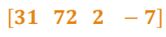
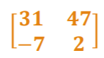
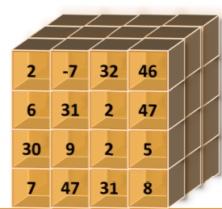
Basic Concepts
Scalars 45
A scalar is a single number
Such as integers, real numbers,
rational numbers, etc.
Matrices
A 2-D array of numbers
Vectors
A vector is a 1-D array of
numbers
Can be real, binary, integer, etc
Tensors
A tensor is an array of
numbers that may have
0-D, 1-D, 2-D, or more

Slide 11
Vectors
Vectors define a magnitude and a direction in a space.
Convenient way to organize data.
In machine learning/data mining, a vector is a collection of features
Define a sample (feature list).
We might have a vector that represents a person's characteristics
Age, Income, Calorie Consumption, Zip Code
Each feature represents a different aspect of the sample, and together they form a feature list or a vector.

Slide 12
Matrices
Matrices are arrays of scalars, usually denoted with uppercase bold letters.
A matrix of order m × n has m rows and n columns.
A vector can therefore be seen as matrix of order n × 1.

Slide 13
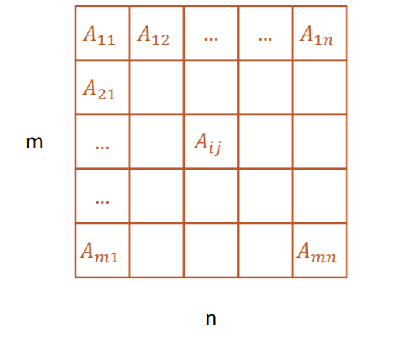
Matrix
2-dimensional matrix with m rows
and n columns

Slide 14
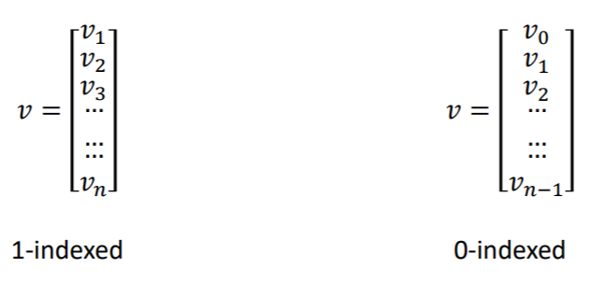
Matrix
A vector can therefore be seen as matrix of order n×1.

Slide 15
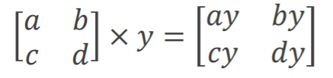
Matrix-Scalar Multiplication
Matrix-scalar multiplication: each element in the matrix is multiplied by the scalar

Slide 16
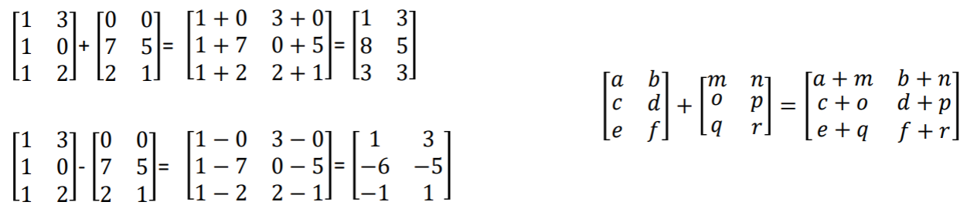
Matrix Addition and Subtraction
Two matrices may be added or subtracted only if they are the same dimension; that is, they must have the same number of rows and columns.

Slide 17
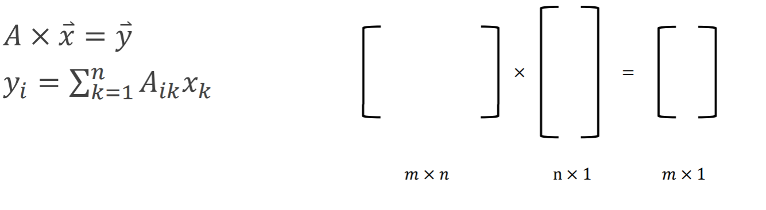
Matrix-Vector Multiplication

Slide 18
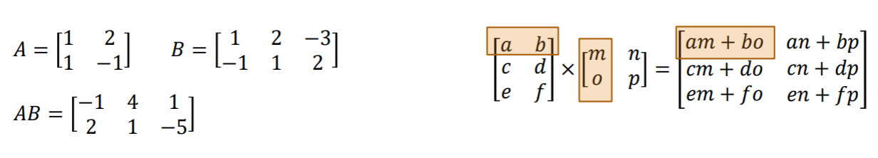
Matrix-Matrix Multiplication
Matrix-by-matrix product AB is defined only when the number of columns in A is the same as the number of rows in B.

Slide 19
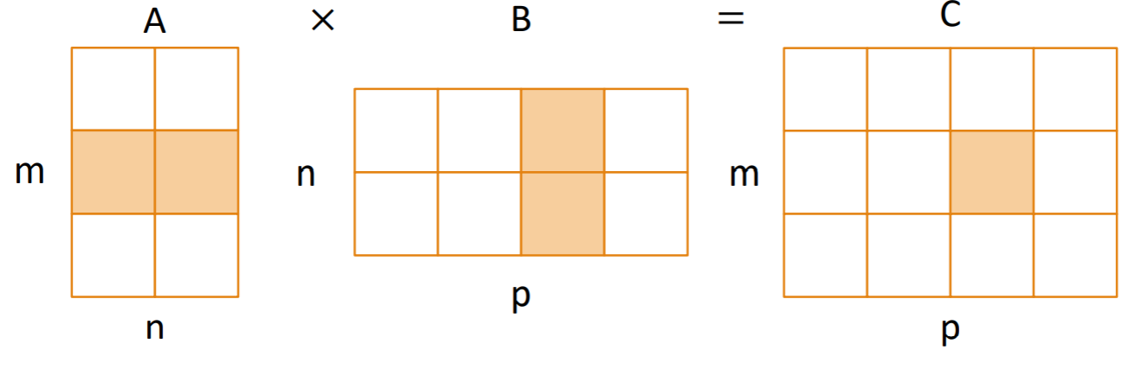
Matrix Multiplication

Slide 20
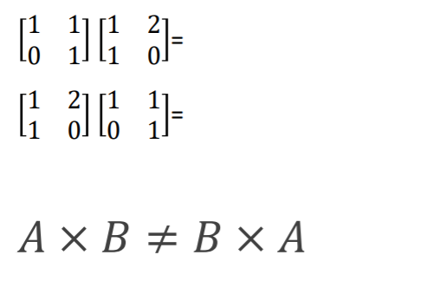
Matrix Properties
Generally, matrices do not commute.
Commutativity sometimes exists.

Slide 21
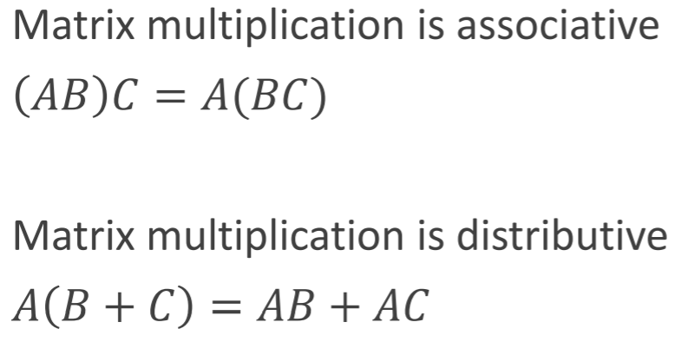
Matrix Properties

Slide 22
Matrix Division
Matrices do not have a direct division operation. Instead:
We can divide by a scalar (constant).
We can multiply by the inverse of another matrix (not all matrices have an inverse).

Slide 23
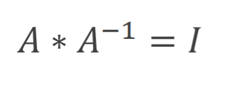
Matrix Inverse
When we multiply a matrix by its inverse, we get the Identity Matrix

Slide 24
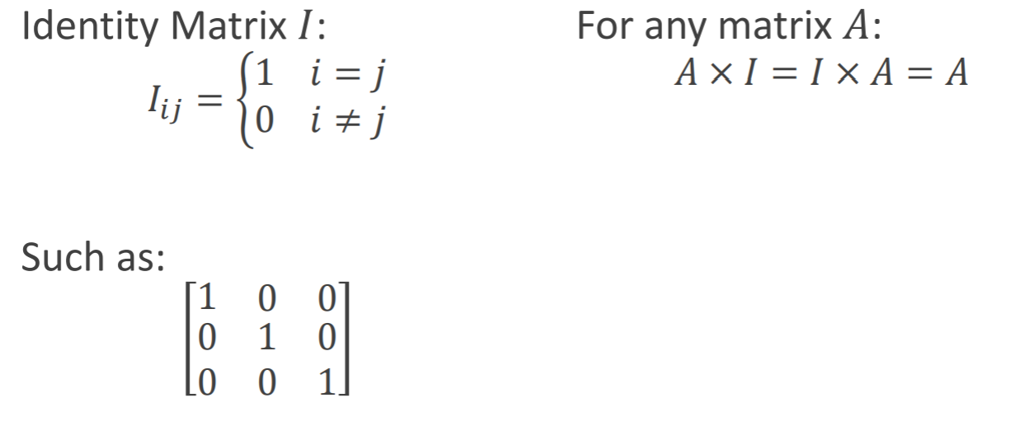
Matrix Inverse

Slide 25
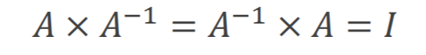
Matrix Inverse
If a square matrix has inverse, then
In the context of matrices, we call a matrix "singular" or "degenerate" if it doesn't have an inverse.

Slide 26
Matrix Invertibility
is a square matrix.
is invertible iff: determinant is non-zero.
is invertible iff: columns are linearly independent, and equivalently, rows are independent.
cannot be inverted if it has redundant rows/columns (“linearly dependent”, “low rank”).

Slide 27
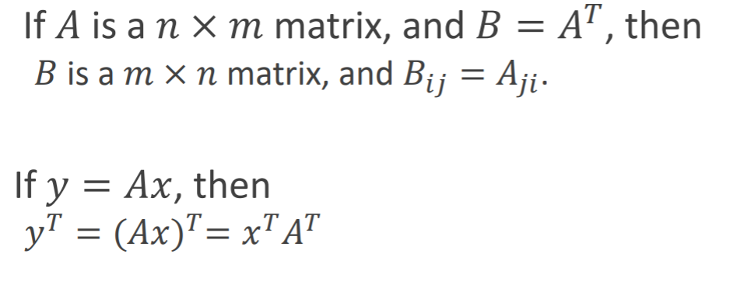
Matrix Transpose
The transpose of a matrix product is the product of the transposed matrices in reverse order.

Slide 28
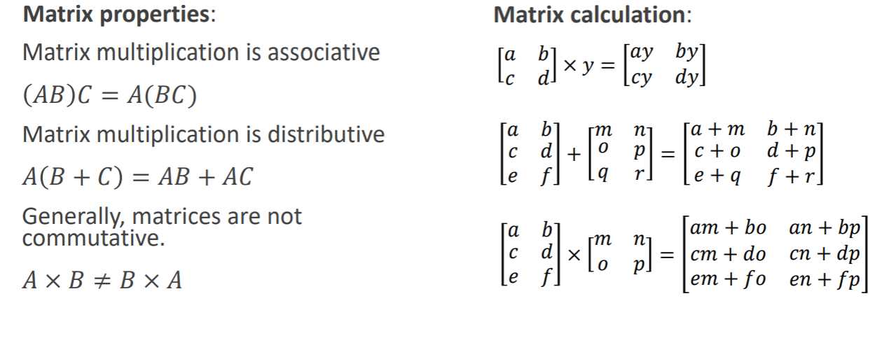
Matrix

Slide 29
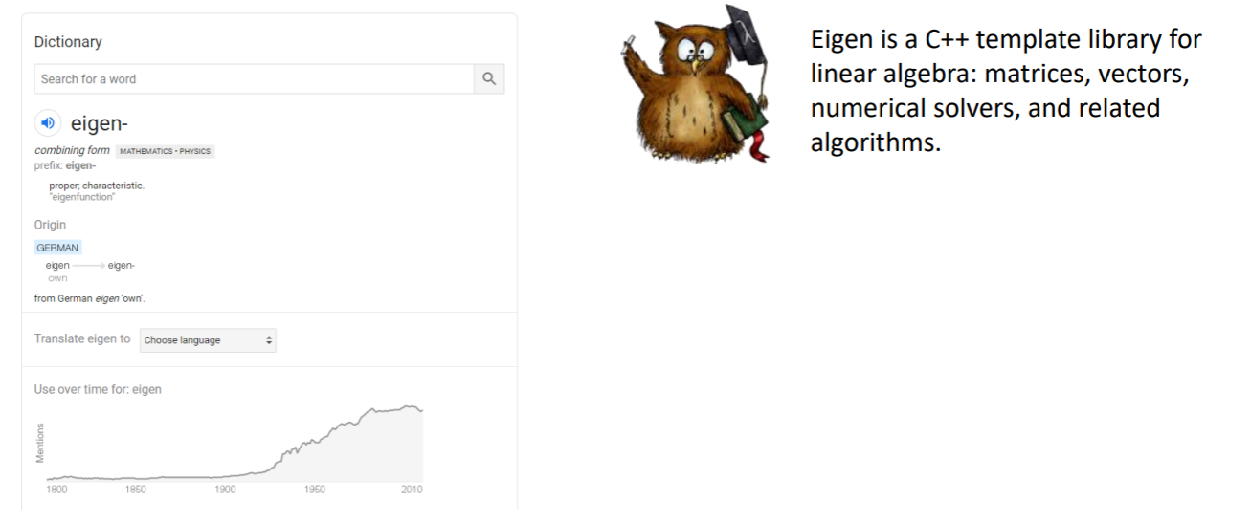
Eigen-vector and Eigen-value

Slide 30
Eigenvalues and Eigenvectors
Eigenvalues are scalar values that represent how the vector changes under a linear transformation. Each eigenvalue corresponds to a specific transformation. They provide information about the scaling factor by which the eigenvector is stretched or shrunk during the transformation.
Eigenvectors are the corresponding vectors that remain in the same direction (up to scalar multiples) after the transformation. They are associated with specific eigenvalues and help us understand the directions along which the transformation has the most significant impact.

Slide 31
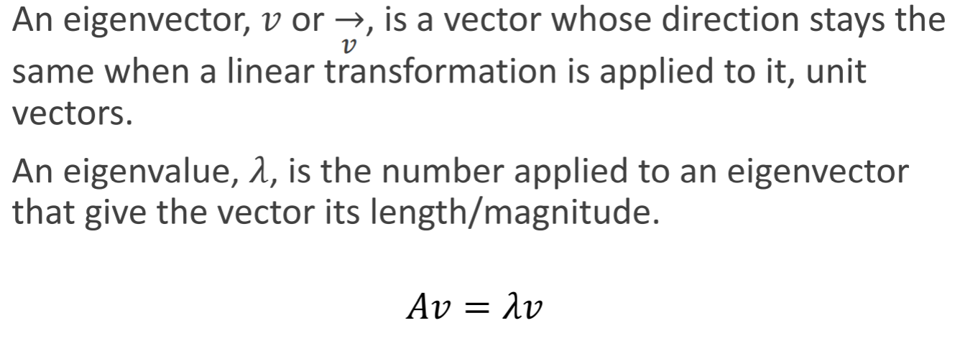
Eigenvalues and Eigenvectors

Slide 32
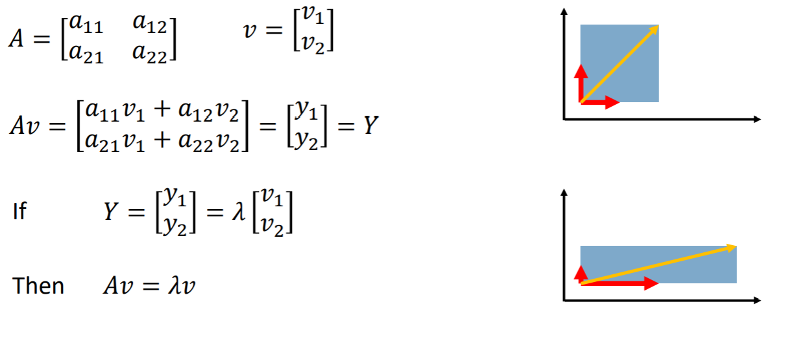
Eigenvalues and Eigenvectors
Eigenvectors (red) do not change direction when a linear transformation (e.g. scaling) is applied to them. Other vectors (yellow) do.

Slide 33
Eigenvalues and Eigenvectors
Eigenvectors and eigenvalues can, in a way, provide a summary of a large matrix.
Eigenvectors and eigenvalues can reduce space dimension and compress data
◦ PCA (Principal Component Analysis)
◦ Face recognition
◦ Reduce noise and improve efficiency
◦ Prevent overfitting

Slide 34
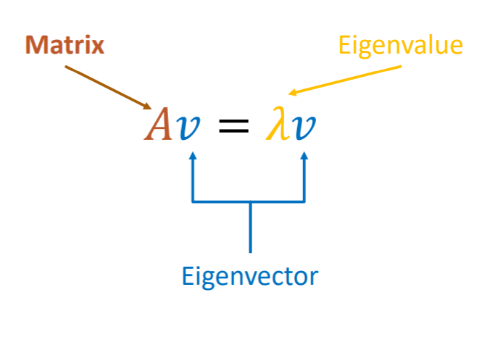
Eigenvalues and Eigenvectors
If A is a square matrix and v is a column vector such that:
Then, V = Eignevector of A
Then, λ = Eignevalue of A

Slide 35
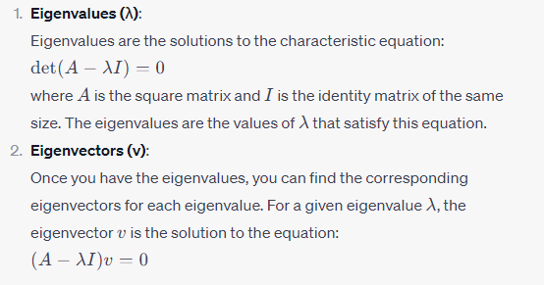
Computation of Eigenvalues and Eigenvectors

Slide 36
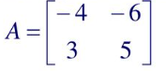
Problem-Eigenvalues and Eigenvectors
Find the eigenvalues and eigenvectors of the matrix

Slide 37
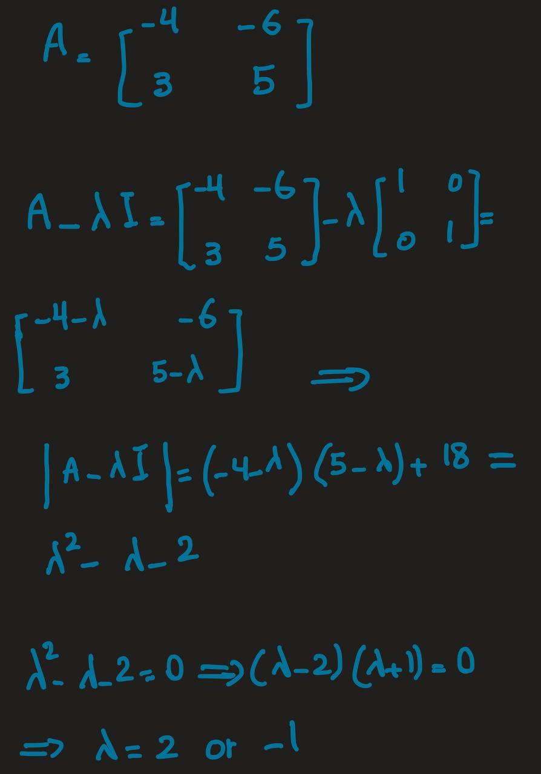
Problem-Eigenvalues and Eigenvectors

Slide 38
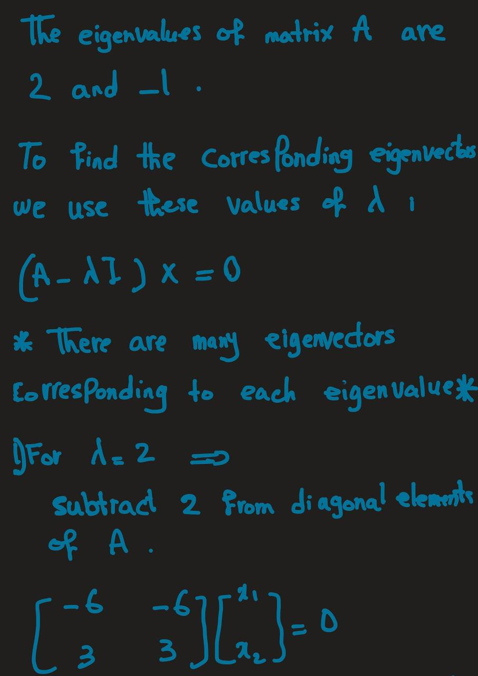
Problem-Eigenvalues and Eigenvectors

Slide 39
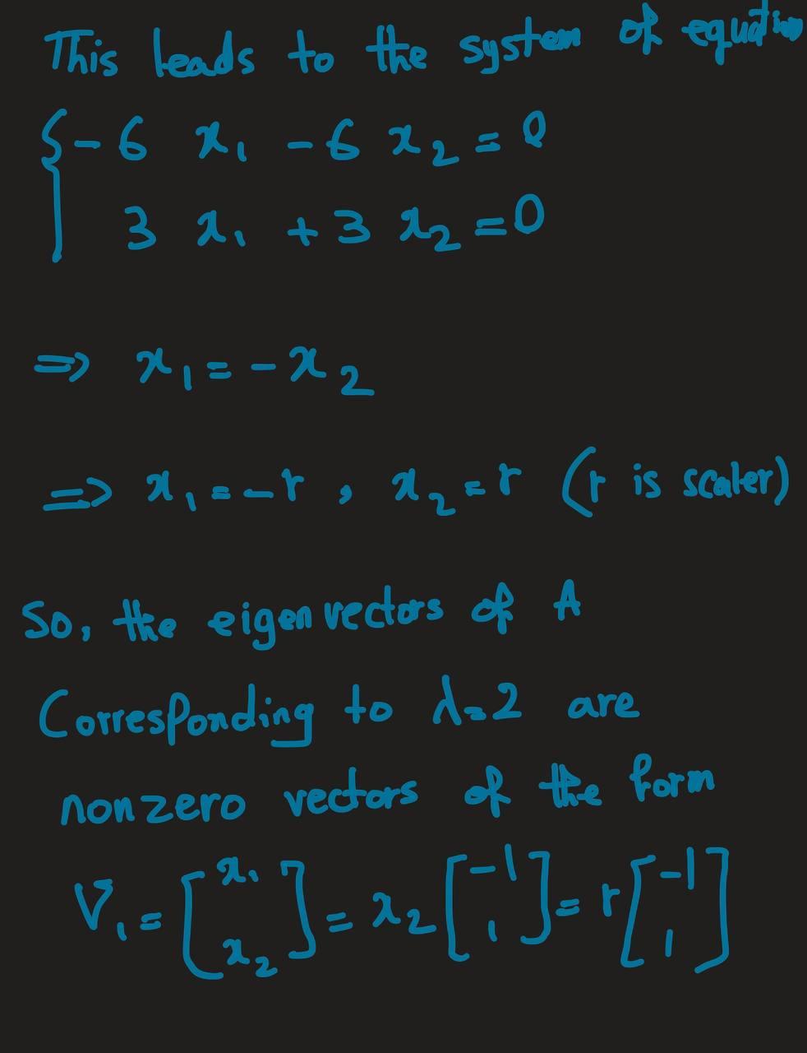
Problem-Eigenvalues and Eigenvectors

Slide 40
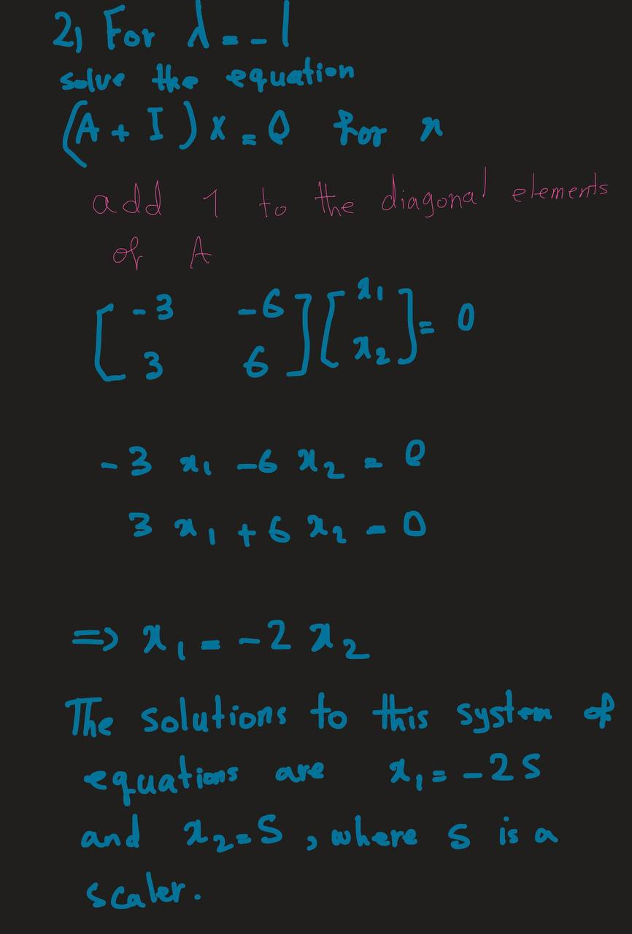
Problem-Eigenvalues and Eigenvectors

Slide 41
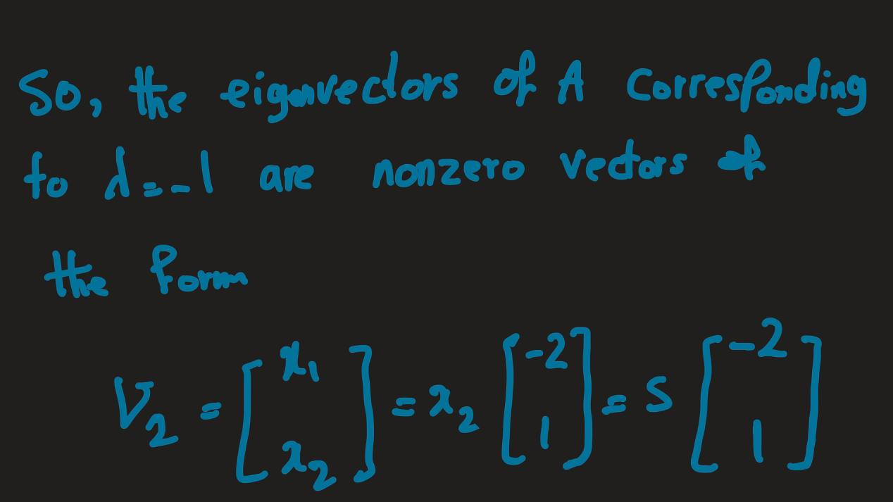
Problem-Eigenvalues and Eigenvectors

Slide 42
Covariance Matrix

Slide 43
Intro
knowing covariance can provide way more information on solving multivariate problems.
It provides valuable information about the relationships and dependencies among variables in a multivariate dataset.
By understanding the covariance between variables, we gain insights into the patterns and connections within the data. For example, a positive covariance indicates that two variables tend to increase or decrease together, while a negative covariance suggests an inverse relationship.
Most of the methods for preprocessing or predictive analysis depend on the covariance.

Slide 44
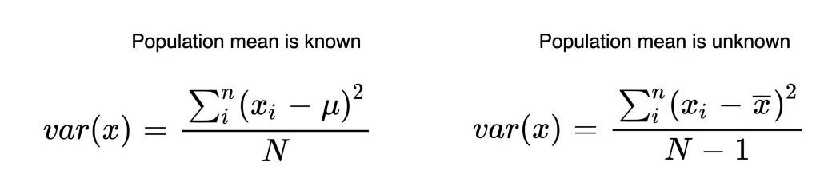
Variance
The variance explains how the values vary in a variable.
Each value in the variable subtracts from the mean of that variable.
After the differences are squared,
Then it gets divided by the number of values (N) in that variable.

Slide 45
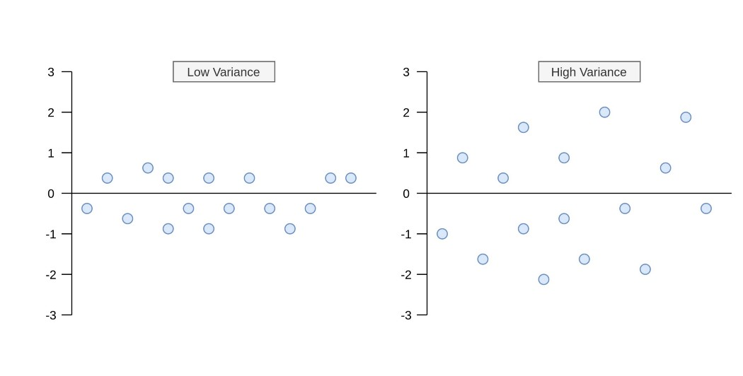
What does it tell us?
Difference between high and low variance
Variance is a measure of the spread or dispersion of values within a variable.

Slide 46
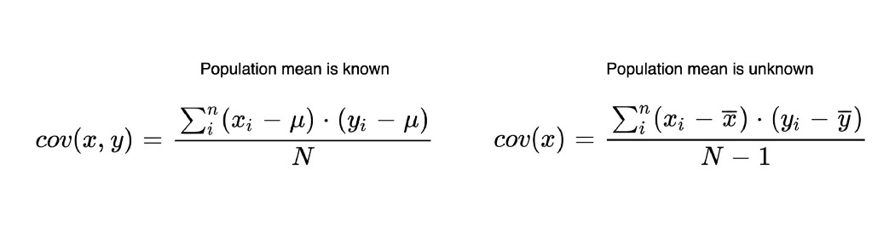
Covariance
Unlike the variance, covariance is calculated between two different variables.
Its purpose is to find the value that indicates how these two variables vary together.
In the covariance formula, the values of both variables are multiplied by taking the difference from the mean.

Slide 47
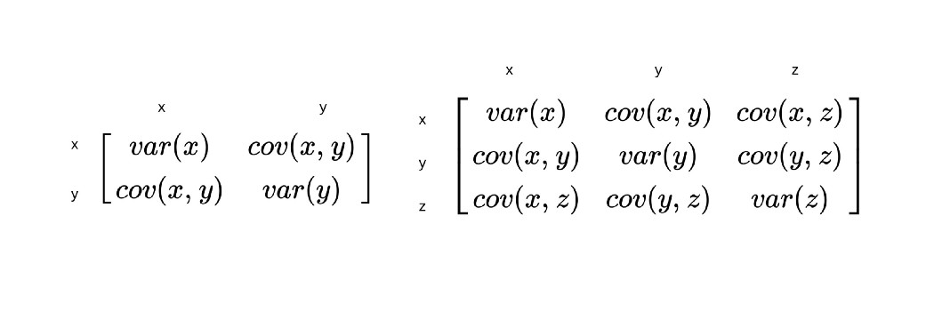
The Covariance Matrix
covariance can only be calculated between two variables
covariance matrices stand for representing covariance values of each pair of variables (features) in multivariate data.
The covariance between the same variables equals variance.

Slide 48
Covariance
It is a symmetric matrix.
It shows covariances of each pair of variables.
These values in the covariance matrix show
The distribution magnitude
The direction
of multivariate data in multidimensional space.

Slide 49
Positive, Negative, and Zero States of The Covariance
When (x – x_bar) and (y – y_bar) are both negative or positive at the same time, multiplication returns a positive value.
If the sum of these values is positive, covariance gets found as positive.
It means variable X and variable Y variate in the same direction.
In short, there is a positive relationship between them.
If there is a negative covariance, this is interpreted right as the opposite. That is, there is a negative relationship between the two variables.

Slide 50
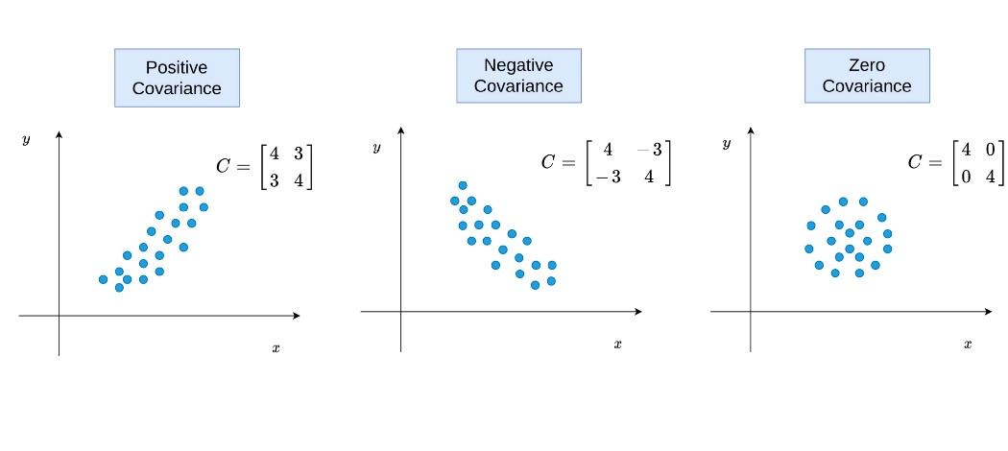
Zero State
The covariance is zero when the sum of products of (x - x_bar) and (y - y_bar) is 0.
In such a scenario, there aren’t any relations between variables.

Slide 51
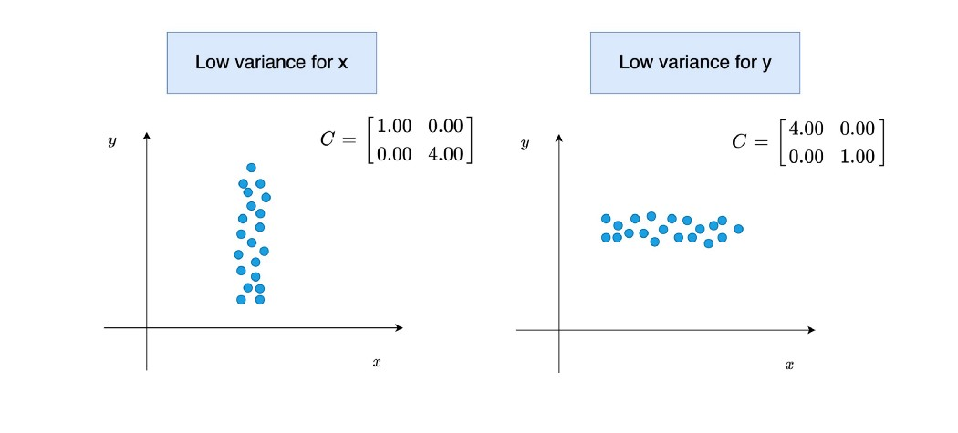

Slide 52
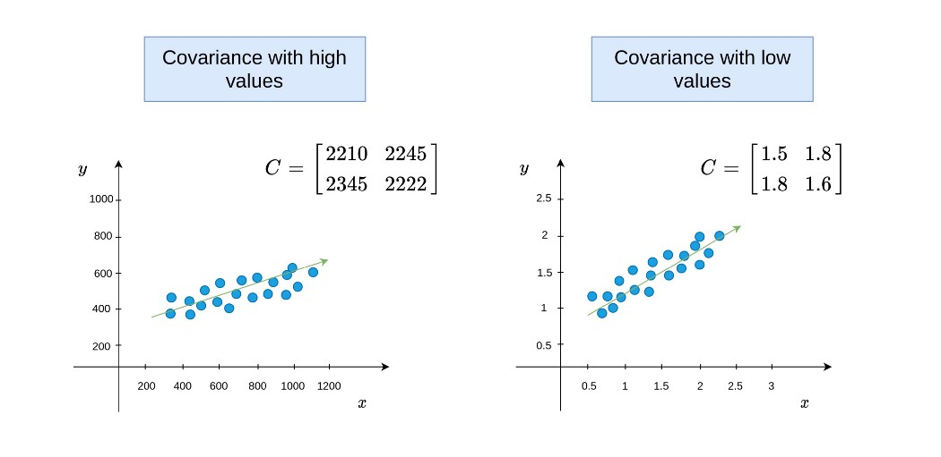
The size of covariance value
Unlike correlation, covariance values do not have a limit between -1 and 1.
It may be wrong to conclude that there might be a high relationship between variables when the covariance is high.

Slide 53
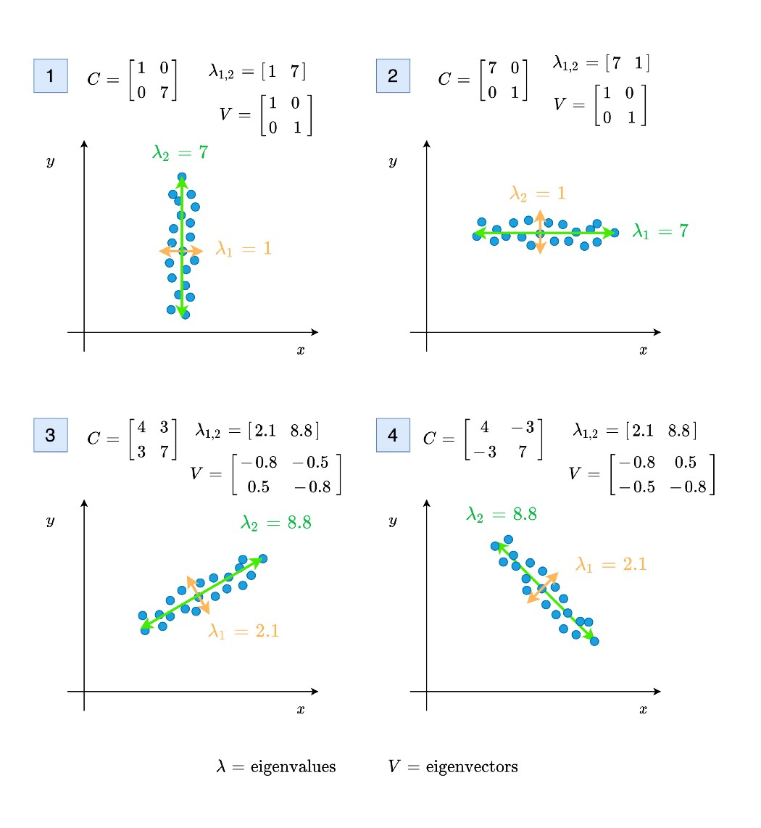
Eigenvalues and Eigenvectors of Covariance Matrix
The methods that require a covariance matrix to find the magnitude and direction of the data points use eigenvalues and eigenvectors.
One of these technique is PCA.
The eigenvalues represent the magnitude of the spread in the direction of the principal components in PCA.
When the covariance is zero, eigenvalues will be directly equal to the variance values.
The eigenvectors show the direction.

Slide 54
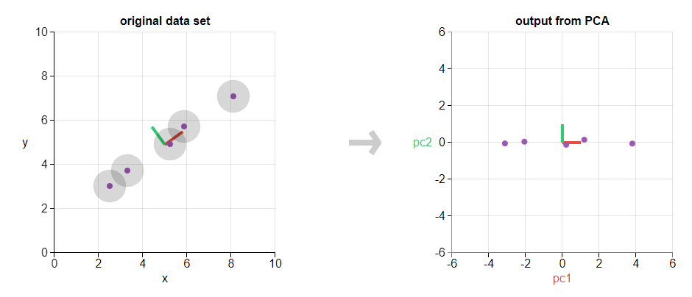
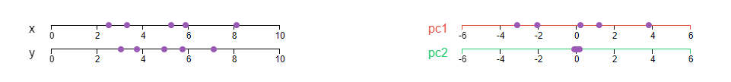
PCA and Eigenthings
The eigenvectors and eigenvalues of a covariance matrix represents the “core” of a PCA!
Source: https://setosa.io/ev/principal-component-analysis/

Slide 55
PCA and Eigenthings
Our goal is to identify directions within the dataset that accounts for the greatest variation. Consequently, our transformation matrix will take the form of the covariance matrix
Principal components (PCs), which are the eigenvectors of the covariance matrix, establish the orientations of the feature space, while their corresponding eigenvalues determine their significance. Put simply, eigenvalues elucidate the extent of data variance captured by the new feature axes.

Slide 56
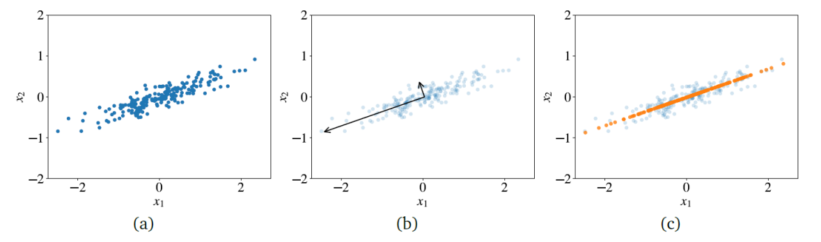
PC Terminology
PCs are vectors that establish a fresh coordinate system. The primary axis aligns with the direction of the greatest variance within the data. The secondary axis, perpendicular to the first, aligns with the direction of the second highest variance in the data.
The original data
Two PC displayed as vectors
The projected data on the first PC
Source: The hundred-page machine learning book

Slide 57
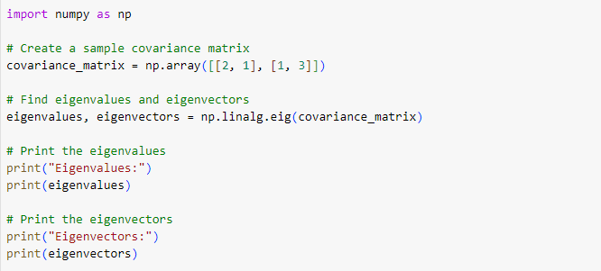
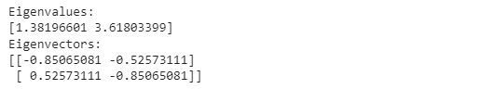
Finding eigenvalues and eigenvectors in Python

Slide 58
Principal Component Analysis (PCA)
Goal: Reduce a set of numerical variables.
The idea: Remove the overlap of information between these variable. [“Information” is measured by the sum of the variances of the variables.]
Final product: A smaller number of numerical variables that contain most of the information

Slide 59
How does PCA do this?
Create new variables that are linear combinations of the original variables (i.e., they are weighted averages of the original variables).
These linear combinations are uncorrelated (no information overlap), and only a few of them contain most of the original information.
The new variables are called principal components.

Slide 60
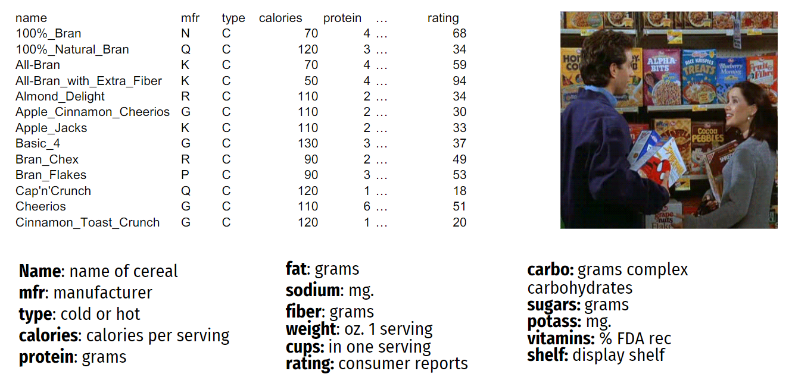
Quick Example: Breakfast Cereals

Slide 61
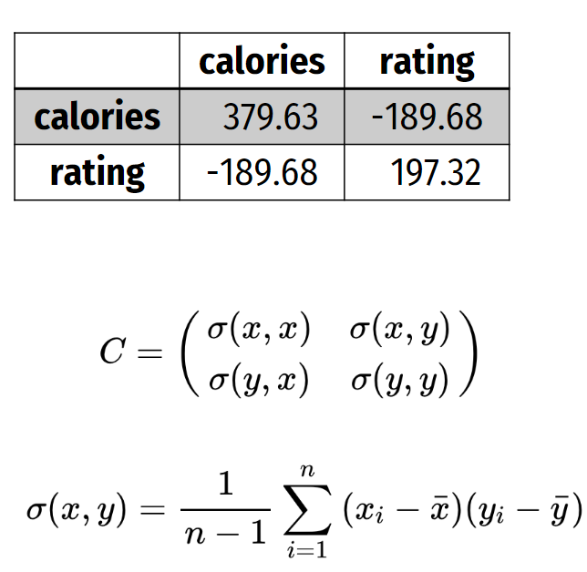
Calories and Ratings Covariance Matrix
Total variance (=“information”) is the sum of individual variances: 379.63 + 197.32
Calories accounts for 379.63/577 = 66%
If we want to make do with just calories, we lose 34% of the variation

Slide 62
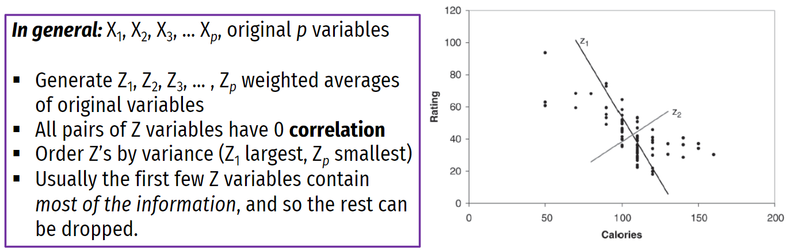
Linear Combinations
Using linear combinations to redistribute the variability in a more polarized way: Z 1 and Z 2 are two linear combinations. Z 1 has the highest variation (spread of values) Z 2 has the lowest variation

Slide 63
Standardization
Using standardization, we center the features at mean 0 and standard deviation 1.
In the cereals dataset example, without standardization, sodium will dominate the first principal component (PC), simply because of the way it is measured (mg): its scale is greater than almost all other variables
Hence its variance will be a dominant component of the total variance
Standardize each variable to remove scale effect
Standardization is usually performed in PCA; otherwise, measurement units affect results.

Slide 64
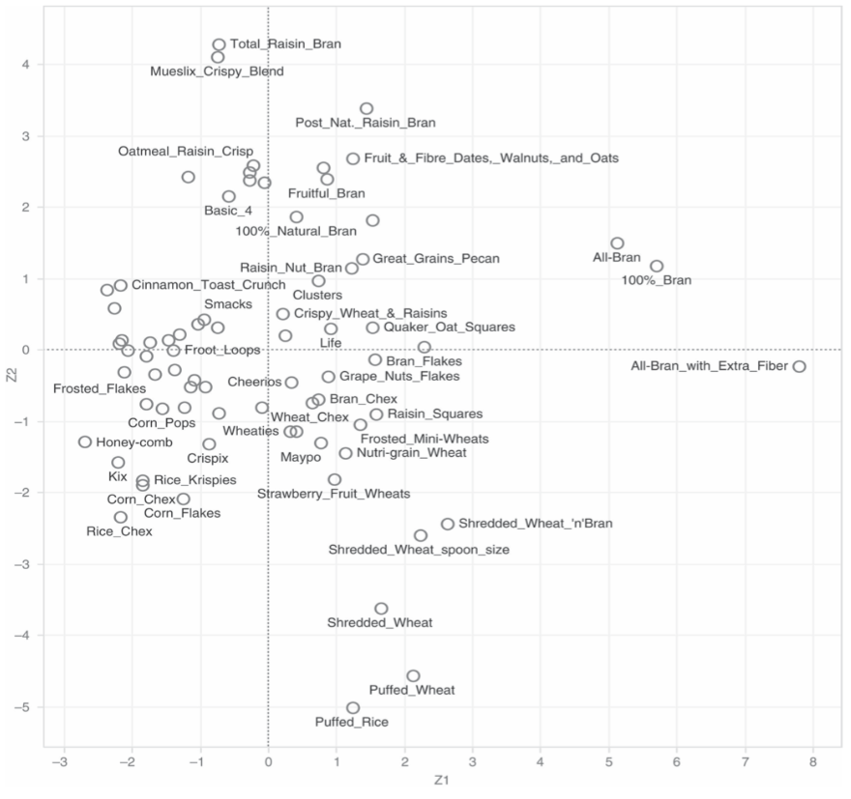
First Two Principal Components
Using (standardized) cereals dataset and 13 different attributes
One can see that PC1 measures the balance between: (1) calories and cups vs. (2) protein, fiber, potassium, and consumer rating. PC2 is most affected by the weight of a serving.
Ideally, one finds a way to “labeling” the principal components in a similar fashion to learn about the structure of the data.

Slide 65
PCA in Classification/Prediction
Sometimes one can consider using PCA as part of a predictive model development.
Apply PCA to training data
Decide how many PC’s to use
Use variable weights in those PC’s with validation/new data
This creates a new reduced set of predictors in validation/new data

Slide 66
Step-by-Step Explanation of PCA
Standardize Your Data
Find the Covariance Matrix
Find the eigenvectors and eigenvalues
Choose Components to Keep
Transform Your Data

Slide 67
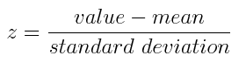
STEP 1:
STANDARDIZATION
Standardize the range of the continuous initial variables so that each one of them contributes equally to the analysis.

Slide 68
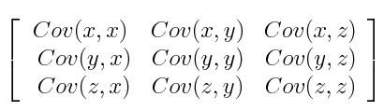
STEP 2:
COVARIANCE MATRIX COMPUTATION
Covariance Matrix for 3-Dimensional Data.
If positive, then: the two variables increase or decrease together (correlated)
If negative, then: one increases when the other decreases (Inversely correlated)

Slide 69
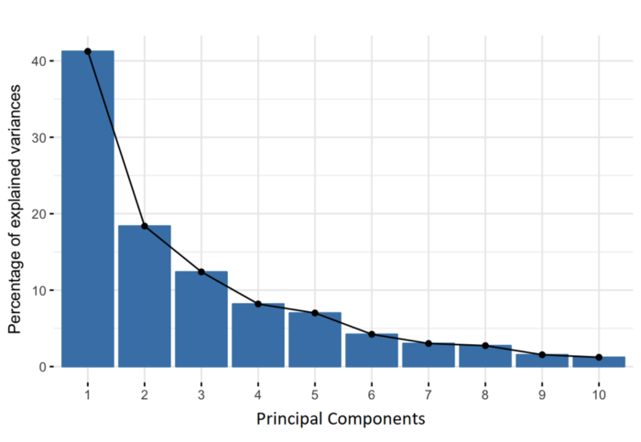
STEP 3:
COMPUTE THE EIGENVECTORS AND EIGENVALUES OF THE COVARIANCE MATRIX TO IDENTIFY THE PRINCIPAL COMPONENTS
Percentage of Variance (Information) for each by PC.

Slide 70

How PCA Constructs the Principal Components
PCs are vectors that define a new coordinate system in which the first axis goes in the direction of the highest variance in the data.

Slide 71
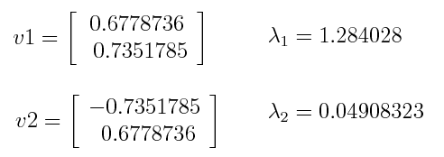
PCA Example
Let’s suppose that our data set is 2-dimensional with 2 variables x,y and that the eigenvectors and eigenvalues of the covariance matrix are as follows:

Slide 72
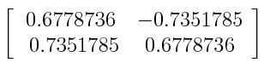

STEP 4: FEATURE VECTOR
keep all these components or discard those of lesser significance (of low eigenvalues), and form with the remaining ones a matrix of vectors that we call Feature vector.
Continuing with the example from the previous step, we can either form a feature vector with both of the eigenvectors v1 and v2:
Or discard the eigenvector v2, which is the one of lesser significance, and form a feature vector with v1 only:

Slide 73

STEP 5
RECAST THE DATA ALONG THE PRINCIPAL COMPONENTS AXES

Slide 74
PCA Pros and Cons
Pros:
Cutting down the number of features to only the most important ones is generally beneficial.
Reducing the dimensions makes it easier to see the data in two or three visual forms.
As part of exploring the data (EDA), this process can be done before training other models to find patterns and see how things are connected.
Using fewer dimensions helps machine learning models work faster, may reduce mistakes (by avoiding too many dimensions), and makes the results simpler to understand.
Cons:
Understanding how it works can be difficult!

Slide 75



Step by Step PCA (Example)
Step 1: Standardize the Data Set
Regarding standardization formula is given below:
For each feature, the mean and the standard deviation were as follows before the standardization.

Slide 76

Standardized data
Preprocessed data

Slide 77


Step 2: Calculate the Covariance Matrix
The resulting covariance matrix is given below.

Slide 78



Step 3
Calculate the Eigenvalues and Eigenvectors of the Covariance Matrix
In our case, solving the equation leads to the result below:

Slide 79


Step 4: Recast the Data
The resulting transformed data is as follows:

Slide 80
References
Course Machine Learning, Dr. Ma, UML
Principal Component Analysis Written by Zakaria Jaadi
https://statisticsglobe.com/
StatQuest: Principal Component Analysis (PCA), Step-by-Step

